Slide 1
Joins in SQL
The SQL JOIN clause is used to combine records from two or more tables in a database.
Remember the foreign key constraint that we discussed during Day 4 of the course. Also remember that the foreign key in the referencing table is the primary key of the referenced table, i.e., values are common to both tables.
Using the foreign key concept, we can retrieve records from multiple tables by joining them.
Hence, a Join can be defined as a medium for combining fields from two or more tables, using the values common to each table.

Slide 2
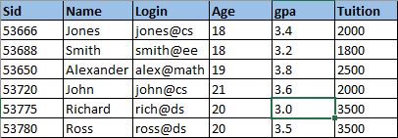
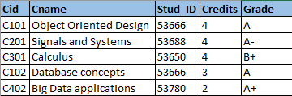
Let us consider our STUDENTS table and add another table named COURSES, which has the student IDs as the foreign key.
In order to join two tables, we need values that are common to both the tables. In this case, the student IDs are common to both tables.
STUDENTS COURSES
You may question why some students are not present in the COURSES table but have a gpa recorded. The limited data is just to explain the concepts but in general all students will enroll for courses.

Slide 3


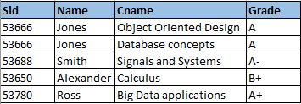
The basic syntax to join two tables is,
Since Sid in STUDENTS table and Stud_ID in COURSES table have values in common, we use them to join both the tables using the below query,
Query
Result

Slide 4
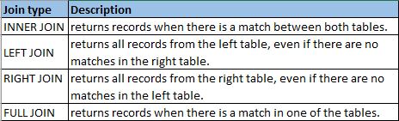
Join Types:
There are different types of joins available in SQL:
We shall see the differences between each of these joins and how they work, using the STUDENTS and COURSES tables.

Slide 5

INNER JOIN:
Also referred to as EQUI JOIN, INNER JOIN is the most frequently used type of join.
The INNER JOIN keyword selects all rows from both tables as long as there is a match between the columns in both tables i.e., values common to both tables.
Ideally INNER JOIN works exactly the same way as the basic join that we discussed in slide 3, just the syntax differs.
The basic syntax of INNER JOIN is,

Slide 6

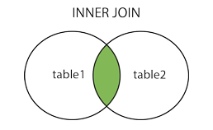
We can join the STUDENTS and COURSES table using INNER JOIN as,
QUERY
RESULT
A pictorial representation of INNER JOIN would look something like,

Slide 7

LEFT JOIN:
The LEFT JOIN keyword returns all records from the left table (table1), with the matching records in the right table (table2).
When there are no matches in the right table, the join will still return a record in the result, but with NULL in each column from the right table.
So a LEFT JOIN returns all the values from the left table, plus matched values from the right table or NULL in case of no matching join condition.
The basic syntax of LEFT JOIN is,

Slide 8

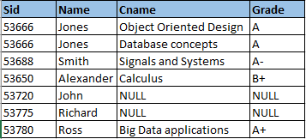
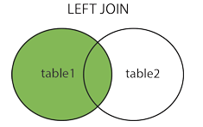
LEFT JOIN between STUDENTS and COURSES table would look like,
QUERY
RESULT
A pictorial representation of LEFT JOIN would look something like,

Slide 9

RIGHT JOIN:
The RIGHT JOIN keyword returns all records from the right table (table2), with the matching records in the left table (table1).
When there are no matches in the left table, the join will still return a record in the result, but with NULL in each column from the left table.
So a RIGHT JOIN returns all the values from the right table, plus matched values from the left table or NULL in case of no matching join condition.
The basic syntax of RIGHT JOIN is,

Slide 10

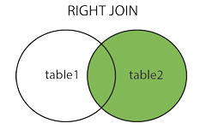
RIGHT JOIN between STUDENTS and COURSES table would look like,
QUERY
RESULT
There are no NULL values in the resultant table since all the records of COURSES(right) table match with the records of STUDENTS(left) table.
Pictorially, a RIGHT JOIN would look like,

Slide 11

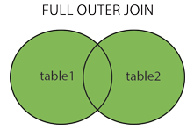
FULL JOIN:
The FULL JOIN keyword returns all records from the left table (table1) and from the right table (table2).
The resultant table will contain all records from both tables, and NULLs for missing matches on either side.
Basically a FULL JOIN combines the results of both LEFT and RIGHT joins.
The basic syntax of FULL JOIN is,
Pictorially, a FULL JOIN would look like,

Slide 12

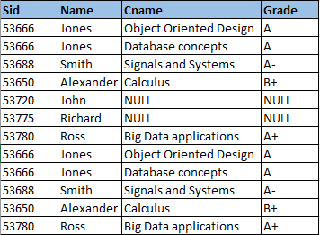
FULL JOIN between STUDENTS and COURSES table would look like,
QUERY
RESULT
As you can see, there are duplicate records in the resultant table since FULL JOIN combines the result of LEFT JOIN and RIGHT JOIN. However duplicates can be eliminated using other statements, which will be discussed in further classes.

